Slide 1
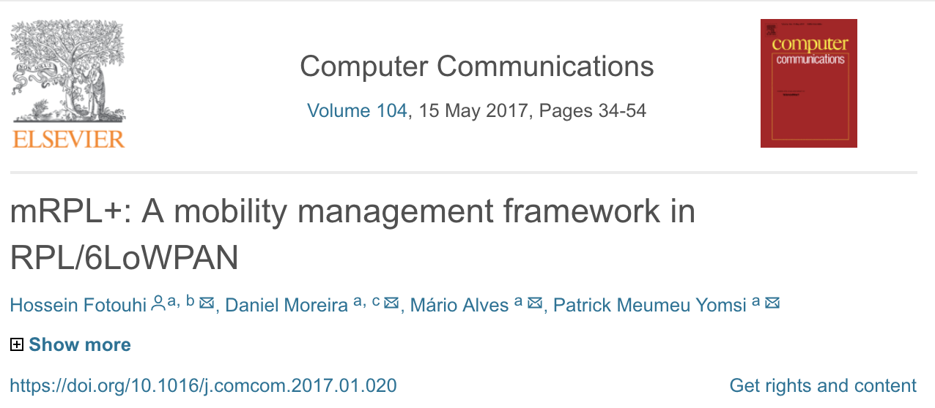
mRPL+: A mobility management framework in RPL/6LoWPAN
Impact Factor: 3.338
5-Year Impact Factor: 2.898
Hossein Fotouhi, Daniel Moreira, Mário Alves, Patrick Meumeu Yomsia

Slide 8
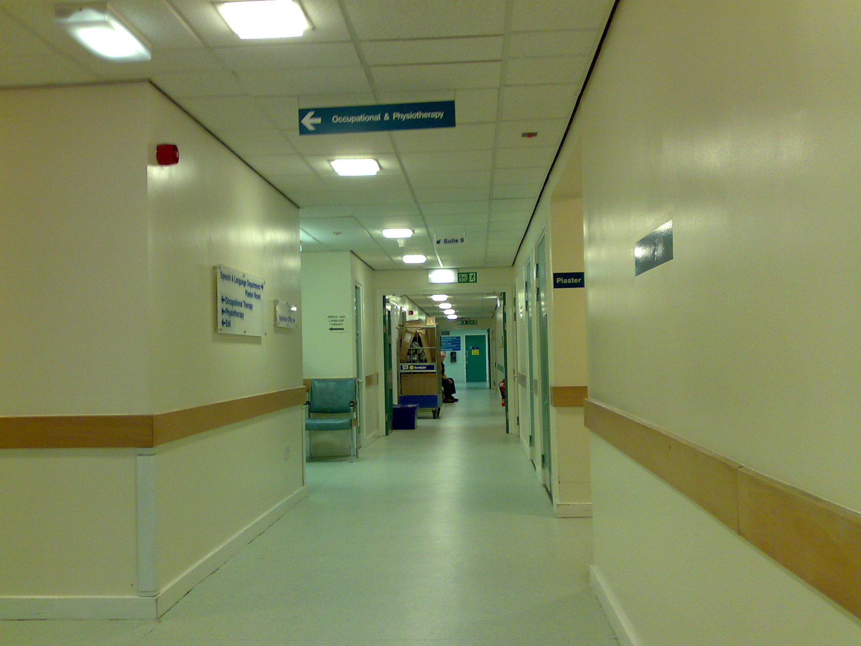
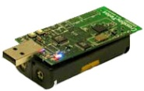
AP6
ARSSI<T_{h}
ARSSI<T_{h}
AP1
ARSSI<T_{h}
ARSSI<T_{h}
AP5
Serving AP
AP2
ARSSI>T_{l}
ARSSI<T_{h}
AP3
AP4

Slide 9
AP6
ARSSI<T_{h}
ARSSI<T_{h}
AP1
ARSSI<T_{h}
ARSSI>T_{h}
AP5
Serving AP
AP2
ARSSI<T_{l}
ARSSI<T_{h}
AP3
AP4

Slide 10
AP6
AP1
Serving AP
AP5
AP2
AP3
AP4
Hand-off delay in mRPL+ = 3 msec
Hand-off delay in mRPL = ~85 msec
Hand-off delay in RPL = 3-10 sec

Slide 13
