Slide 1
Demo Abstract: Real-time Heterogeneous Edge Computing System for Social Sensing Applications
Yue Zhang, Nathan Vance, and Dong Wang
Department of Computer Science and Engineering
University of Notre Dame
IEEE RTAS 2018, Porto, Portugal

Slide 2
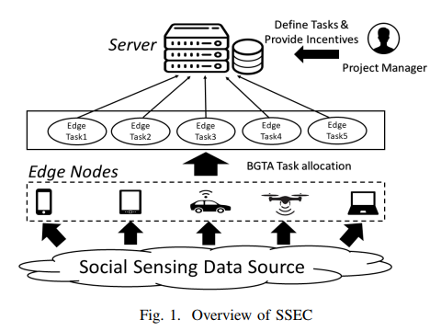
Social Sensing based Edge Computing (SSEC)
Edge computing pushes applications, data and computing power (services) away from centralized servers (e.g., cloud) by performing data processing at the edge of the network, where social sensing occurs (near the sources of data).
Advantages:
Low latency and high responsiveness
Low requirement on the network bandwidth
Notes:
The edge computing has emerged as a new computing paradigm where the computation is pushed from the cloud to the edge of the networks. It explores the massive amount of computation power at edge devices (such as smartphones, wearable computing devices, drones, etc.) by processing the data at the edge of the networks. We found edge computing can be nicely integrated with our work in social sensing since social sensing also occurs at the edge of networks. In this direction, we proposed a social sensing based edge computing paradigm that could provide efficient computation to the social sensing data near the data sources and reduce the end-end delay and bandwidth consumption of the applications.

Slide 3
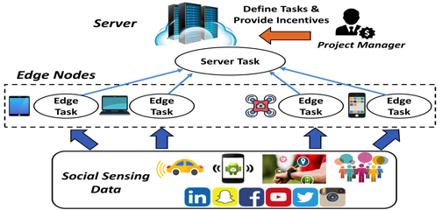
Application Task Allocation in SSEC
When and Where should computation tasks be executed?
 | Cooperative-ness | Latency | Bandwidth Consumption | Computing power | Power Supply
Backend Server | Fully cooperative | High | High | Powerful | Power line
Edge Device | Non-cooperative | Low | Low | Limited | Battery
Backend
Edge
Notes:
Use a table to list the pros and cons of server and edge [page numbers]
The key question we try to answer in the opportunistic computation allocation problem is when and where to run the computation tasks in the system? In traditional cloud computing systems, all the computation is done in the back-end servers. Those servers often have high computation power and can finish the task efficiently. However, there is a potential problem of experiencing high delay of the applications because you need to send everything from the edge to the backend servers. This also imposes a big requirement on the network bandwidth for data transmission. In contrast, a lot of computation can be done at the edge of the networks by leveraging the edge devices. This could greatly reduce the delay the application experienced and imposes less requirement on the network bandwidth. However, how to allocate the task among edge devices become a non-trivial question due to a few unique challenges of running social sensing applications in edge computing system.

Slide 4
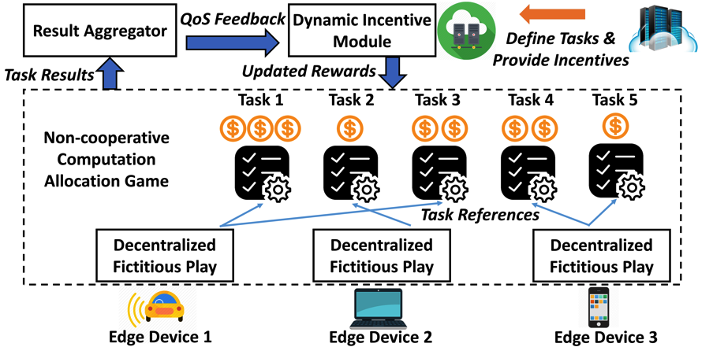
Bottom-up Game-theoretic Task Allocation
Notes:
Add animations to navigate
To address the above challenges, we developed a bottom-up game-theoretic task allocation framework to address the task allocation problem in social sensing based edge computing system. The key idea of the solution is to let the devices compete and pick the tasks by themselves by providing the incentives from the applications. In particular, the server defines the computation tasks and assign the rewards to each task based on the computation complexity of this task and the data involved. The rewards can be monetary rewards (e.g., cash or virtual currency) or non-monetary (e.g., contribution/experience scores, competitive rankings). We also define a payoff function for each edge device that is a function of the reward of a task and the cost finishing this task at this particular edge device. Then, the edge devices pick their favorable tasks through a game theory model. The server then dynamically adjusts the rewards of the tasks based on the task allocation results (e.g., increase the reward of the tasks no one picks).
Each player can only pick one item (i.e. task) at a time (singleton property). The reasons for using such a rule are two folds: (i) the introduction
of the singleton property reduces the strategy space from O(N^2) to O(N) ; (ii) the Pure Strategy Nash Equilibrium is guaranteed to exist under the singleton weighted congestion
game protocol, which is crucial for the edge nodes to make mutually satisfactory task allocation decisions.
Yes, it depends on the data volume and complexity. For BGTA I assume the tasks are generated in a top-down fashion where the server has prior knowledge of the tasks (criticality and data size). The intuition is that the server should have a reasonable estimate how much data it wants to collect. In ICDCS and Sensys paper, I assume the data are generated bottom-up and the server has no prior knowledge of the tasks, Therefore, the edge device has to ping the local edge server to tell it the incoming data size.
Server define tasks
Server assign rewards to each task
Edge nodes pick their favorite tasks via Game Theory
Server dynamically adjust rewards for each task based on performance feedback
Such rewards can be monetary rewards (e.g., cash or virtual currency) or non-monetary (e.g., contribution/experience scores, competitive rankings).
Each player can only pick one item (i.e. task) at a time (singleton property). The reasons for using such a rule are two folds: (i) the introduction
of the singleton property reduces the strategy space from O(N^2) to O(N) ; (ii) the Pure Strategy Nash Equilibrium is guaranteed to exist under the singleton weighted congestion
game protocol, which is crucial for the edge nodes to make mutually satisfactory task allocation decisions.

Slide 5
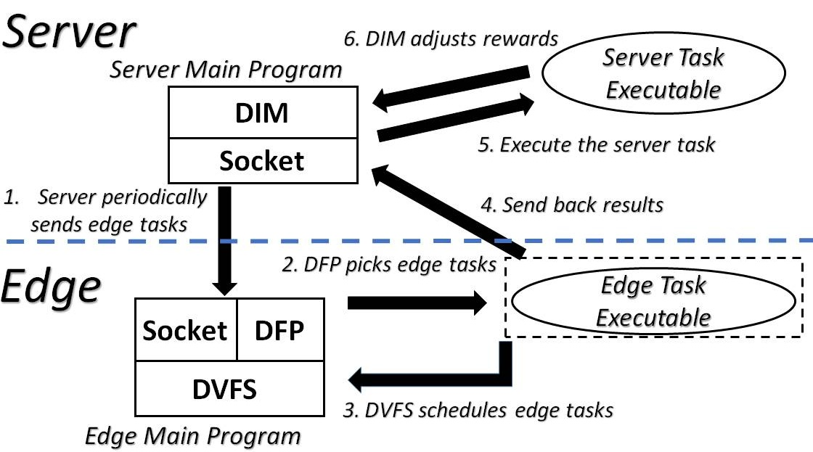
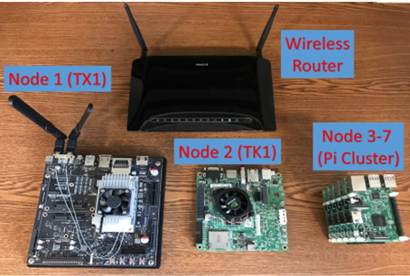
Demo: Heterogenous Edge Computing Platform
Module Diagram
Hardware Setup
Notes:
This is a snapshot of the experiment platform we setup for the edge computing system. It consists of heterogeneous edge nodes such as Jetson TX1 and TK1 nodes as well as Raspberry PI nodes.
We use FLUKE AC/DC current clamps [51] to monitor real-time current signal of each edge device and capture the current values using a National Instruments USB-6216 Data Acquisition (DAQ) system

Slide 6
Thank You!
Question?

